Slide 1



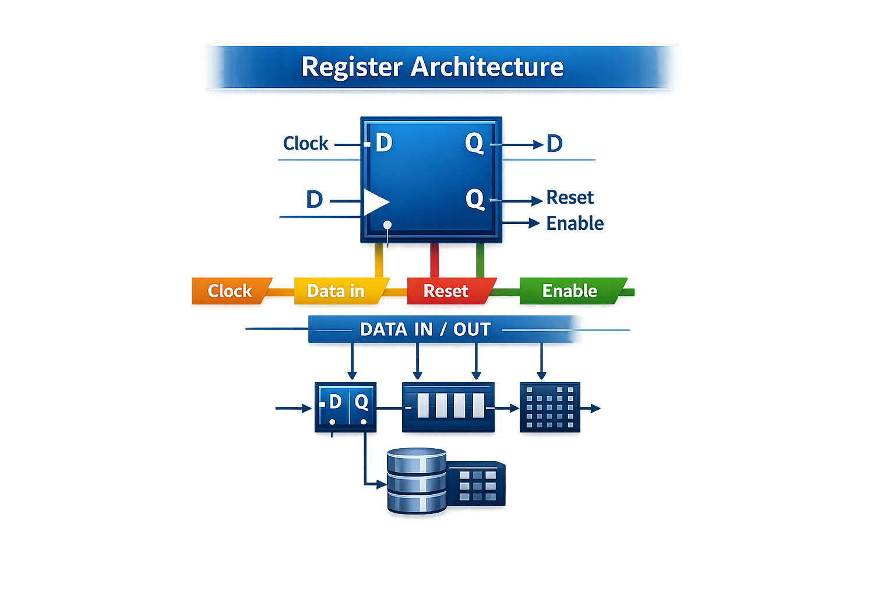
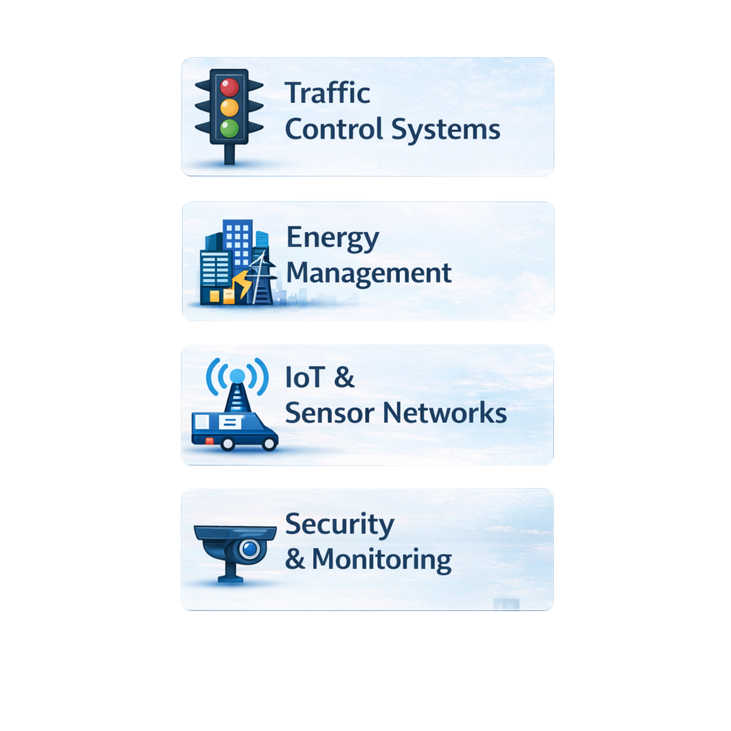
International Scientific Conference
“ALFATECH – Smart Cities and modern technologies – 2026”
REGISTERS IN MODERN SYSTEMS
AND SMART DIGITALCITIES
Name of the first author1, Name of the second author2, etc.
1) Name of institution, city, country (first institution)
2) Name of institution, city, country (other institution
Siniša Andrijević
Alfa BK University, Belgrade, Serbia
TECHNICAL CHARACTERISTICS OF THE POSTER
The poster for the work presentation is made in B1 paper format (707mm × 1000mm) and must not exceed the specified dimensions. The poster template is in MS PowerPoint format.
POSTER CONTENTS
Below the poster's header, in the corresponding text fields, the title of the work and information about the author/authors and institutions must be entered in the manner indicated in the form.
Prescribed font sizes and styles:
1. The title of the paper – Arial, 72 pt, Centered, All Caps
2. Information about the author/authors and institution/institutions - Arial, 28 pt, Centered
The authors recommended that the poster contain the following elements:
- Summary: description of the research in brief, extract and present the results;
- Introduction: emphasize the goals set in the research;
- Methods, results: to present the results, use simple graphics (tables, graphs, pictures) and accompanying legends for more straightforward navigation;
- Conclusion: It should be short and precise; highlight other results, trends, and directions for future research.
Authors can add other parts that they consider necessary (literature, acknowledgements, etc.).
SUMMARY
Registers are key components in digital systems enabling fast and deterministic data processing.
This study examines their role in smart city and IoT environments.
INTRODUCTION
Importance of registers in digital systems
Need for real-time data processing in smart cities
Objectives: Analyze register architecture and applications.
CONCLUSION
Enabling real-time, reliable processing
Essential for smart city infrastructure
Supports scalability & energy efficiency
February 28, 2025, Belgrade, Serbia, Alfa BK University
Faculty of Information and Communication Technology, Faculty of Mathematics and Computer Science
March 6, 2026, Belgrade, Serbia, Alfa BK University
Faculty of Information and Communication Technology, Faculty of Mathematics and Computer Science

